Slide 1
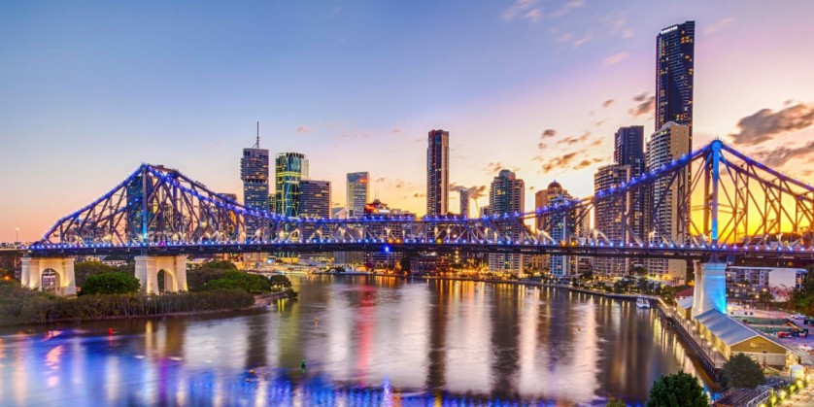
SmartCity To Do Brisbane
Team 67 - “Just Put Something Down”: User Stories

Slide 2
System Roles
Legend
Role 0: User
Role 1: Student
Role 2: Tourist
Role 3: Businessman
Role 4: Admin
MOSCOW
M: must have
S: should have
C: could have
W: won’t

Slide 3
01
Welcome Page
M
Story Points: 4
As a user, I want to see a welcome page, so that I can understand the services that are on offer.
Acceptance Criteria
Buttons to navigate website
Website logo
Industry standard colour scheme
Login option on side
Notes:
Industry standard colour scheme continued throughout site

Slide 4
02
Create New Account
M
Story Points:4
As a user, I want to create an account, so that I can start using the system.
Acceptance Criteria
Entry form provided
Password textbox shows asterisks
Entry form shows two buttons
Validation of form
Notes:
Entry form contains fields for username, password, retype password, phone number, address
Password textboxes do not contain characters, for security reasons, only asterisks
Entry form buttons are submit and clear

Slide 5
03
Login
M
Story Points: 4
As a user, I want to log into my account, so that I can access information whenever needed.
Acceptance Criteria:
Web standard login form
Validation of existing account
Password shown in asterisks
Notes:
GUI code: front end and back end
Validation shows successful or unsuccessful login

Slide 6
04
Other Views
S
Story Points: 2
As a user, I want to see information available to other user types, so that I can see information that might not be available under my account type.
Acceptance Criteria:
Check boxes for user type
Users default automatically checked
Ability to check other boxes
Notes:
User type is either one of roles
If another box is checked they only see the checked box information, not both
Logout happens if browser is excited

Slide 7
05
Student Homepage
M
Story Points:2
As a student, I want to see information on colleges, libraries and the city so that I can see information related to my needs.
Acceptance Criteria:
Show city name
Show information relevant to students
Can check other user type
Notes:
- Once other user type is checked, they can only view that type of information

Slide 8
06
Tourist Homepage
M
Story Points: 2
As a tourist, I want to see information on hotels and city information, so that I can see information related to my needs.
Acceptance Criteria:
Show city name
Show information relevant to tourists
Can check other use type
Notes:
- Within database separate tables for user and city information

Slide 9
07
Business Homepage
M
Story Points: 2
As a businessman, I want to see information on hotels, industries, and the city, so that I can see information related to my needs.
Acceptance Criteria:
Show city name
Show industry information
Can check other user type
Notes:
-

Slide 10
08
Admin Account
M
Story Points: 4
As an admin, I want to have administrative privileges, so that I can make changes to the system.
Acceptance Criteria:
Have first admin account for Susan
Able to add data in database
Able to update data in database
Notes

Slide 11
09
Create More Admin Accounts
M
Story Points: 4
As an admin, I want to create admin accounts, so that I can share administration rights.
Acceptance Criteria:
Link to separate admin account creation page
Form to create other admin accounts
Admin information access to database
Notes:
- Admin is the only role that can access the database

Slide 12
10
Create Database
M
Story Points: 4
As an admin, I want to create a database, so that I can fill it with relevant information.
Acceptance Criteria:
Industry standard database designed
Database linked to website
Create/modify database information
Notes:
- Separate database tables for users and other attraction types

Slide 13
11
Populate Database
M
Story Points: 4
As an admin, I want to store the city information in the database, so that the website has access to all information.
Acceptance Criteria:
Table is populated with city data
Data covers all information
User tables specifies user details
Notes:
Data covers all information on users, colleges, libraries, industries, hotels, parks, zoos, museums, restaurants, malls.

Slide 14
12
Other Cities
C
Story Points: 8
As a user, I want to see information on cities other than Brisbane, so that I can plan ahead before I travel.
Acceptance Criteria:
Database on other cities
Option to choose other cities
One city can only be utilised at a time
Notes:

Slide 15
13
Public Service Information
C
Story Points: 8
As a user, I want to see information on public services, so that I can plan my trip.
Acceptance Criteria:
Information stored in database
Option to choose other services
One service can be selected at a time
Notes:
- bus/rail services, government offices, health services, business

Slide 16
14
Saving Attractions
C
Story Points: 8
As a user, I want to be able to save my attractions, so that I can keep updated with my preferences.
Acceptance Criteria:
Tab for favourited attractions
Only have 5 saved at once
Prioritised by date saved
Notes

Slide 17
15
Location Utilization
C
Story Points: 8
As a user, I want the system to access my devices location, so that I do not have to enter my location manually.
Acceptance Criteria:
Directions to attraction
Distance to attraction
Verification to use device
Show GPS location of user
Notes:
In metrics associated by users home country

Slide 18
16
Languages Available
C
Story Points: 8
As a user, I want the system to have multiple languages available, so that I can utilise it in a different language.
Acceptance Criteria:
Language tab on page
Check boxes for language
Only one language at a time
Notes:
- Languages will progress as the website locations expand

Slide 19
17
Secure Data
M
Story Points: 4
As a user, I want the system to securely store my data, so that I am not at threat of my information being stolen.
Acceptance Criteria:
Personal information stored in secure database
Encrypted information
Access of information by admin only
Notes:
- Use a secure encryption service

Slide 20
18
Upload Map
S
Story Points: 4
As an administrator, I want to upload a map, so that users can see a map of where attractions are.
Acceptance Criteria:
Implement Google Maps API
Option to upload map
Option to update map
Notes:
- More maps can be uploaded as city information expands

Slide 21
19
Comparing Attractions
C
Story Points: 4
As a user, I want to be able to compare attractions, so that I am able to pick the best option for myself.
Acceptance Criteria:
Review of attraction
Current address of attraction
Updated picture of attraction
Notes
- Users can review attractions

Slide 22
20
Information Tab
C
Story Points: 2
As a user, I want there to be a FAQ tab, so that I can find answers to any issues.
Acceptance Criteria:
Information tab on the homepage
Updated information for current issues
Questions formatted into groups
Notes:
- Questions to be formatted into groups of similar questions, so the FAQ section can be easily navigated

Slide 23
21
Online Question Chat
C
Story Points: 8
As a user, I want there to be a live chat, so that my questions can be answered.
Acceptance Criteria:
Live question tab
Talking to an admin
Provides information from database
Notes:

Slide 24
22
Email Updates
C
Story Points: 2
As a user, I want to be updated via email, so that I can be notified of new and popular attractions.
Acceptance Criteria:
Email sent out to user
New database information in email
Shows attraction based on user type
Notes:
- Every time information is updated in database, user gets an email

